Slide 1

A Concise Linear Encoding of Crystallographic Space Group Settings and Group-Subgroup Relationships (CLEG)
Robert M. Hanson
St. Olaf College
American Crystallographic Association
74th Annual Meeting,
Denver, Colorado
9 July 2024

Slide 2
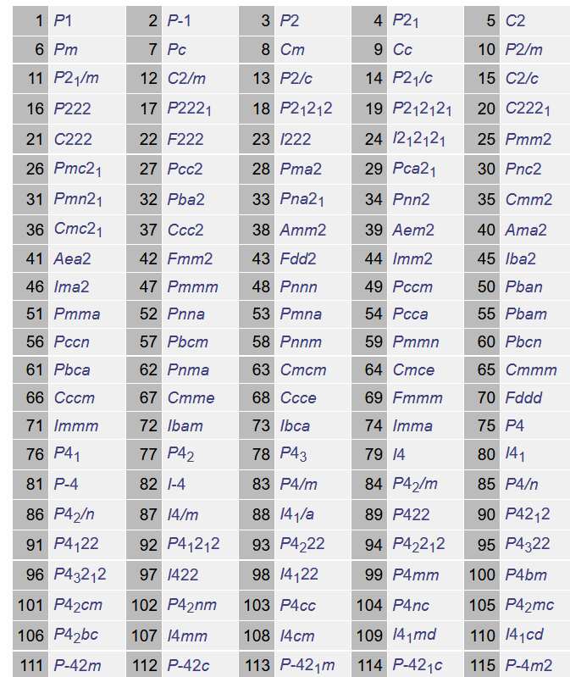
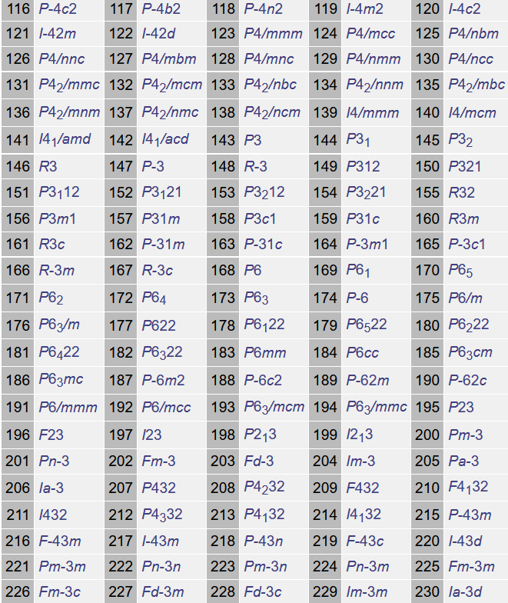
Introduction: Space group settings
The International Tables identifies the 230 space groups that are possible for crystal structures.
https://github.com/BobHanson/CLEG

Slide 3
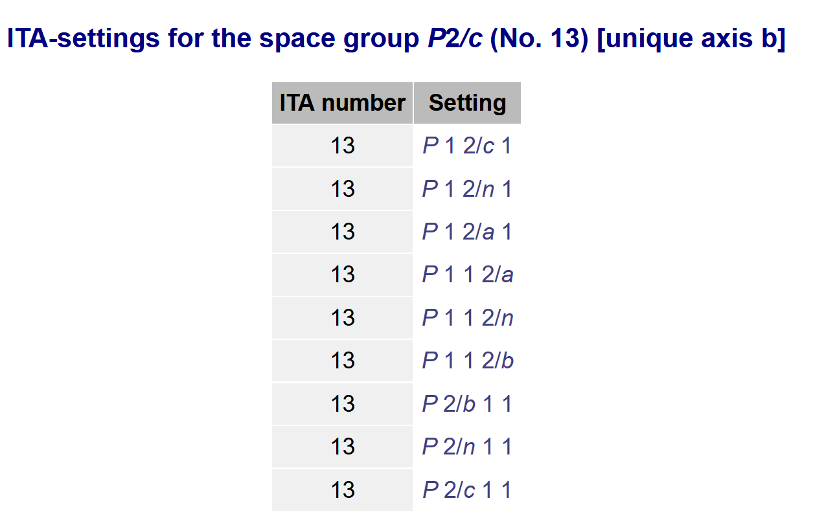
Introduction: Space group settings
Each space group can be described using multiple settings.
The BCS identifies 611 “conventional” space group settings.
https://github.com/BobHanson/CLEG

Slide 4
Introduction: Space group settings
One setting is the “standard” setting.
https://github.com/BobHanson/CLEG

Slide 5
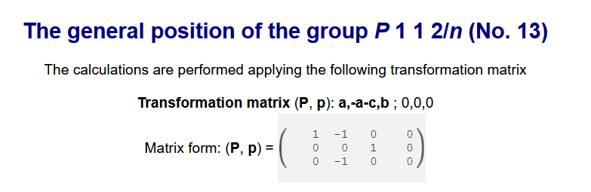
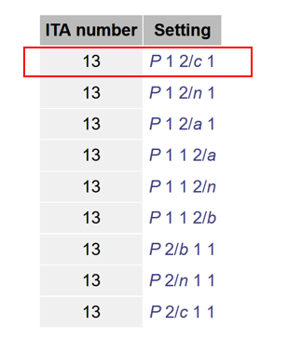
Introduction: Space group settings
The BSC describes settings using matrix transformations in relation to the standard setting.
The inline “(P,p)” notation describes the matrix in a convenient linear column-based format.
https://github.com/BobHanson/CLEG

Slide 6
Introduction: Group-Subgroup relationships
When comparing crystal structures, we are often interested in how their symmetries differ.
How do their lattices compare?
What symmetry elements have been lost or gained?
What sort of distortions relate one structure to another?
https://github.com/BobHanson/CLEG

Slide 7
Introduction: Group-Subgroup relationships
The BSC also describes subgroup relationships using (P,p) matrices.
https://github.com/BobHanson/CLEG

Slide 8
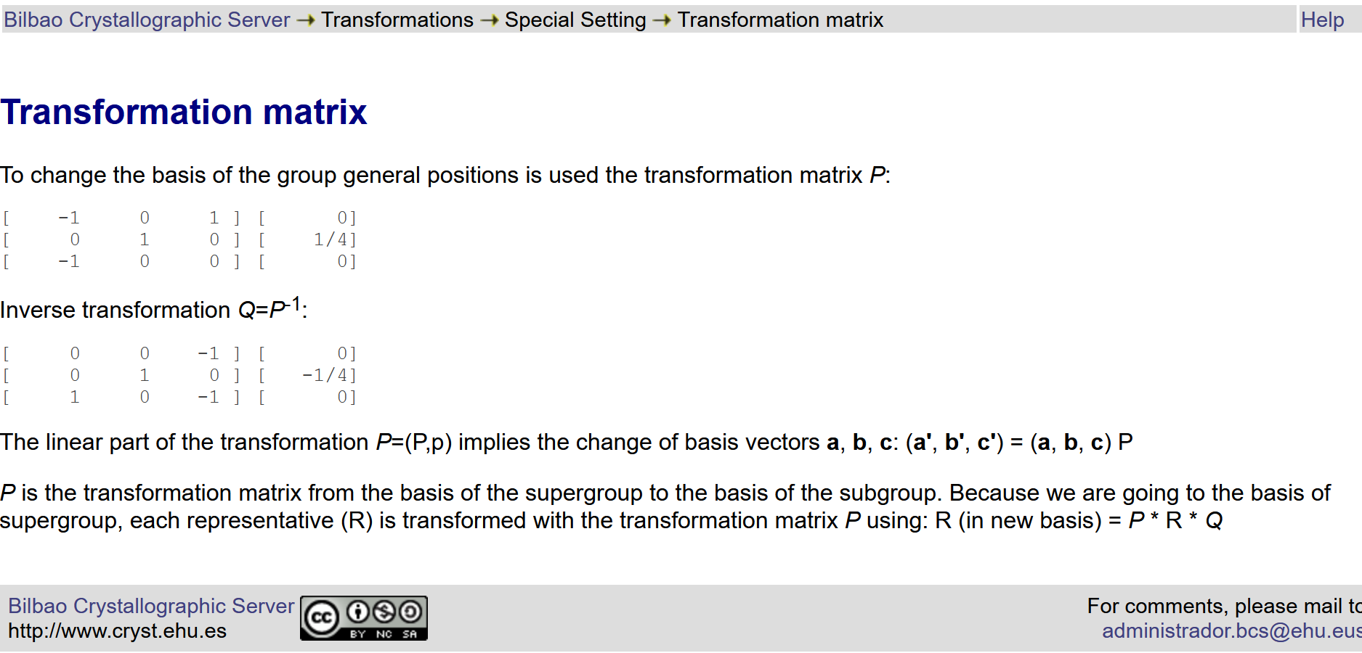
Introduction: Group-Subgroup relationships
https://github.com/BobHanson/CLEG

Slide 9
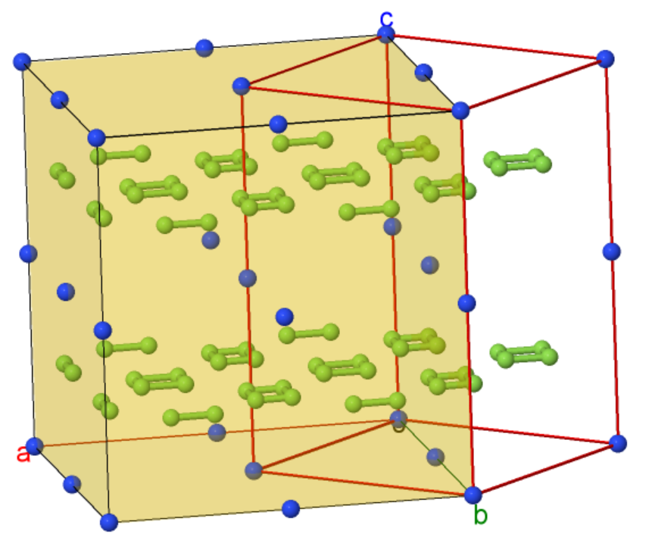
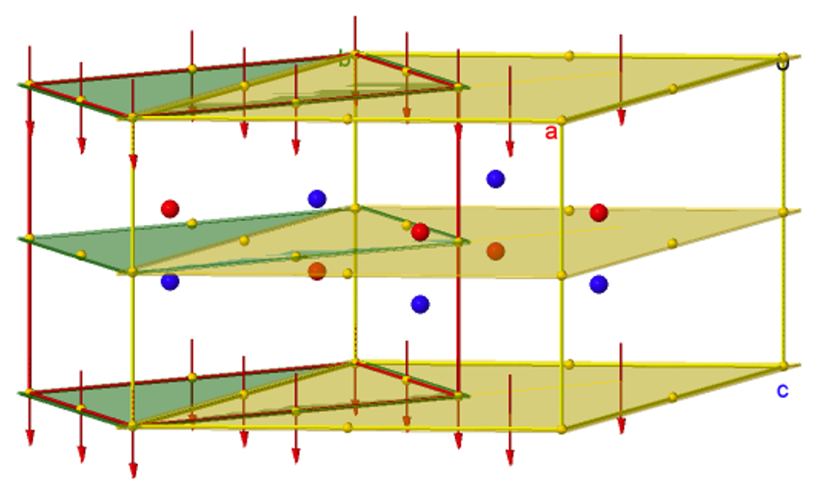
My challenge: modeling settings and subgroup relationships in Jmol
https://github.com/BobHanson/CLEG

Slide 10
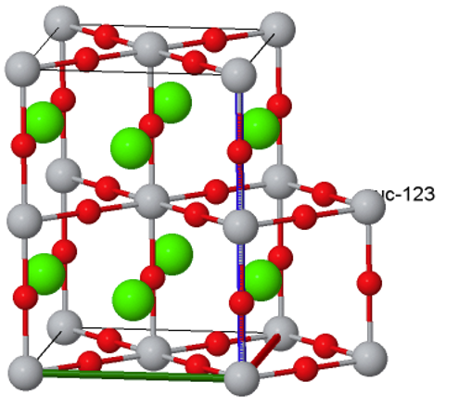
The Problem: How to express relationships concisely
Simple, concise
Comprehensive
Flexible
https://github.com/BobHanson/CLEG

Slide 11
The Problem: How to express relationships concisely
Simple, concise
Comprehensive
Flexible
Linear string of characters
Scriptable
https://github.com/BobHanson/CLEG

Slide 12
The Solution: CLEG
A Concise Linear Encoding of Crystallographic Space Group Settings and Group-Subgroup Relationships (CLEG)
Settings: Combine ITA space group number with BCS (P,p) notation:
P 1 2/m 1 | 10:a,b,c;0,0,0 | P 1 2/c 1 | 13:a,b,c;0,0,0
P 1 1 2/m | 10:c,a,b;0,0,0 | P 1 1 2/n | 13:a,-a-c,b;0,0,0
P 2/m 1 1 | 10:b,c,a;0,0,0 | P 2/b 1 1 | 13:b,c,a;0,0,0
https://github.com/BobHanson/CLEG

Slide 13
The Solution: CLEG
A Concise Linear Encoding of Crystallographic Space Group Settings and Group-Subgroup Relationships (CLEG)
Settings: Combine ITA space group number with BCS (P,p) notation:
Simple!
P 1 2/m 1 | 10:a,b,c;0,0,0 | P 1 2/c 1 | 13:a,b,c;0,0,0
P 1 1 2/m | 10:c,a,b;0,0,0 | P 1 1 2/n | 13:a,-a-c,b;0,0,0
P 2/m 1 1 | 10:b,c,a;0,0,0 | P 2/b 1 1 | 13:b,c,a;0,0,0
https://github.com/BobHanson/CLEG

Slide 14
The Solution: CLEG
A Concise Linear Encoding of Crystallographic Space Group Settings and Group-Subgroup Relationships (CLEG)
Settings: Allow for defaults “a,b,c” and “;0,0,0” :
P 1 2/m 1 | 10 | P 1 2/c 1 | 13
P 1 1 2/m | 10:c,a,b | P 1 1 2/n | 13:a,-a-c,b
P 2/m 1 1 | 10:b,c,a | P 2/b 1 1 | 13:b,c,a
https://github.com/BobHanson/CLEG

Slide 15
The Solution: CLEG
A Concise Linear Encoding of Crystallographic Space Group Settings and Group-Subgroup Relationships (CLEG)
Settings: Allow for defaults “a,b,c” and “;0,0,0” :
Concise!
P 1 2/m 1 | 10 | P 1 2/c 1 | 13
P 1 1 2/m | 10:c,a,b | P 1 1 2/n | 13:a,-a-c,b
P 2/m 1 1 | 10:b,c,a | P 2/b 1 1 | 13:b,c,a
https://github.com/BobHanson/CLEG

Slide 16
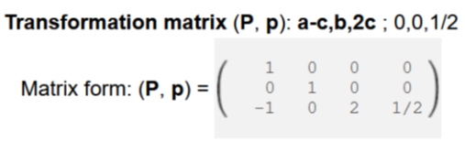
The Solution: CLEG
A Concise Linear Encoding of Crystallographic Space Group Settings and Group-Subgroup Relationships (CLEG)
Subgroups: Expand ITA “P2/m > P2/c” notation:
10 > a-c,b,2c;0,0,1/2 > 13
https://github.com/BobHanson/CLEG

Slide 17
The Solution: CLEG
A Concise Linear Encoding of Crystallographic Space Group Settings and Group-Subgroup Relationships (CLEG)
Subgroups: Add “!” meaning “not” or “inverse of”:
10:b,c,a > !b,c,a > 10
https://github.com/BobHanson/CLEG

Slide 18
The Solution: CLEG
A Concise Linear Encoding of Crystallographic Space Group Settings and Group-Subgroup Relationships (CLEG)
Subgroups: Allow chaining:
10:b,c,a > !b,c,a > 10
10 > a-c,b,2c;0,0,1/2 > 13
13 > a,-a-c,b > 13:a,-a-c,b
-----------------------------------
?
https://github.com/BobHanson/CLEG

Slide 19
The Solution: CLEG
A Concise Linear Encoding of Crystallographic Space Group Settings and Group-Subgroup Relationships (CLEG)
Subgroups: Allow chaining by :
10:b,c,a > !b,c,a > 10 $ P1 = matrix("!b,c,a”)
10 > a-c,b,2c;0,0,1/2 > 13 $ P2 = matrix(“a-c,b,2c;0,0,1/2”)
13 > a,-a-c,b > 13:a,-a-c,b $ P3 = matrix(“a,-a-c,b“)
-----------------------------------
$ P = $P1 * $P2 * $P3
https://github.com/BobHanson/CLEG

Slide 20
The Solution: CLEG
A Concise Linear Encoding of Crystallographic Space Group Settings and Group-Subgroup Relationships (CLEG)
Subgroups: Allow chaining:
10:b,c,a > !b,c,a > 10
10 > a-c,b,2c;0,0,1/2 > 13 $ print matrix("!b,c,a > a-c,b,2c;0,0,1/2 > a,-a-c,b", "abc")
13 > a,-a-c,b > 13:a,-a-c,b -b+c,-b-c,a;0,1/2,0
-----------------------------------
10:b,c,a > -b+c,-b-c,a:0,1/2,0 > 13:a,-a-c,b
https://github.com/BobHanson/CLEG

Slide 21
The Solution: CLEG
A Concise Linear Encoding of Crystallographic Space Group Settings and Group-Subgroup Relationships (CLEG)
10:b,c,a > !b,c,a > 10 nonstandard to standard setting
10 > a-c,b,2c;0,0,1/2 > 13 group to subgroup (standard settings)
13 > a,-a-c,b > 13:a,-a-c,b standard to nonstandard
10:b,c,a > -b+c,-b-c,a:0,1/2,0 > 13:a,-a-c,b nonstandard group to nonstandard subgroup
https://github.com/BobHanson/CLEG

Slide 22
The Solution: CLEG
A Concise Linear Encoding of Crystallographic Space Group Settings and Group-Subgroup Relationships (CLEG)
Examples
Comprehensive!
10:b,c,a > !b,c,a > 10 nonstandard to standard setting
10 > a-c,b,2c;0,0,1/2 > 13 group to subgroup (standard settings)
13 > a,-a-c,b > 13:a,-a-c,b standard to nonstandard
10:b,c,a > -b+c,-b-c,a:0,1/2,0 > 13:a,-a-c,b nonstandard group to nonstandard subgroup
https://github.com/BobHanson/CLEG

Slide 23
The Solution: CLEG
A Concise Linear Encoding of Crystallographic Space Group Settings and Group-Subgroup Relationships (CLEG)
Allow Hermann-Mauguin notation?
(for human consumption only!)
P 2/m 1 1 > !b,c,a > P 2/m nonstandard to standard setting
P 2/m > a-c,b,2c;0,0,1/2 > P 2/c group to subgroup (standard settings)
P 2/c > a,-a-c,b > P 1 1 2/n standard to nonstandard
P 2/m 1 1 > -b+c,-b-c,a;0,1/2,0 > P 1 1 2/n nonstandard group to nonstandard subgroup
https://github.com/BobHanson/CLEG

Slide 24
The Solution: CLEG
A Concise Linear Encoding of Crystallographic Space Group Settings and Group-Subgroup Relationships (CLEG)
Q: Allow Hall notation (for standard setting only)
(completely machine readable; no ITA referencing)
(-P 2y):b,c,a > !b,c,a > (-P 2y) nonstandard to standard setting
(-P 2y) > a-c,b,2c;0,0,1/2 > (-P 2cy) group to subgroup (standard settings)
(-P 2cy) > a,-a-c,b > (-P 2cy):a,-a-c,b standard to nonstandard
(-P 2y):b,c,a > -b+c,-b-c,a:0,1/2,0 > (-P 2cy):a,-a-c,b nonstandard group to nonstandard subgroup
https://github.com/BobHanson/CLEG

Slide 25
The Solution: CLEG
A Concise Linear Encoding of Crystallographic Space Group Settings and Group-Subgroup Relationships (CLEG)
Q: Allow Hall notation (for standard setting only)
(completely machine readable; no ITA referencing) Flexible!
(-P 2y):b,c,a > !b,c,a > (-P 2y) nonstandard to standard setting
(-P 2y) > a-c,b,2c;0,0,1/2 > (-P 2cy) group to subgroup (standard settings)
(-P 2cy) > a,-a-c,b > (-P 2cy):a,-a-c,b standard to nonstandard
(-P 2y):b,c,a > -b+c,-b-c,a:0,1/2,0 > (-P 2cy):a,-a-c,b nonstandard group to nonstandard subgroup
https://github.com/BobHanson/CLEG

Slide 26
CLEG applications
tabular description of BCS group/maximal subgroup relationships through index 4:
i | cleg | tr_type | tr_subtype | det | index | conj_class
1 | 1>2a,a+b,a+c>1 | k | eu | 2 | 2 | a
2 | 1>2a,a+b,c>1 | k | eu | 2 | 2 | b
3 | 1>2a,b,a+c>1 | k | eu | 2 | 2 | c
191 | 8>a-2c,b,2c>9 | k | eu | 2 | 2 | a
192 | 8>a,b,2c>9 | k | eu | 2 | 2 | b
193 | 9>1/2a-1/2b,1/2a+1/2b,c>1 | t |  | 0.5 | 2 | a
194 | 9>a,b,-a+c;0,1/4,0>7 | k | ct | 1 | 2 | a
202 | 9>a,b,3c>9 | k | eu | 3 | 3 | e
203 | 10>a,b,c>2 | t |  | 1 | 2 | a
204 | 10>a,b,c>3 | t |  | 1 | 2 | a
205 | 10>a,b,c>6 | t |  | 1 | 2 | a
206 | 10>a-c,b,2c;0,0,1/2>10 | k | eu | 2 | 2 | a
1558 | 69>-b,a,c>64 | k | ct | 1 | 2 | c
1559 | 69>b,c,a>64 | k | ct | 1 | 2 | d
1560 | 69>c,a,b>64 | k | ct | 1 | 2 | e
1561 | 69>c,b,-a>64 | k | ct | 1 | 2 | f
1562 | 69>a,b,c>65 | k | ct | 1 | 2 | a
1563 | 69>c,a,b>65 | k | ct | 1 | 2 | b
3764 | 230>a-b,b+c,-1/2a-1/2b+1/2c;1/2,0,1/2>167 | t |  | 1.5 | 4 | a
3765 | 230>a,b,c>206 | t |  | 1 | 2 | a
3766 | 230>a,b,c>214 | t |  | 1 | 2 | a
3767 | 230>a,b,c>220 | t |  | 1 | 2 | a
https://github.com/BobHanson/CLEG

Slide 27
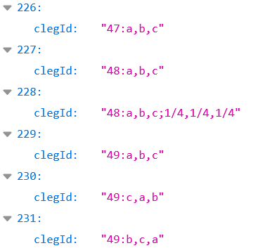
CLEG applications
JSON description of ITA space group settings for Jmol:
https://github.com/BobHanson/CLEG

Slide 28
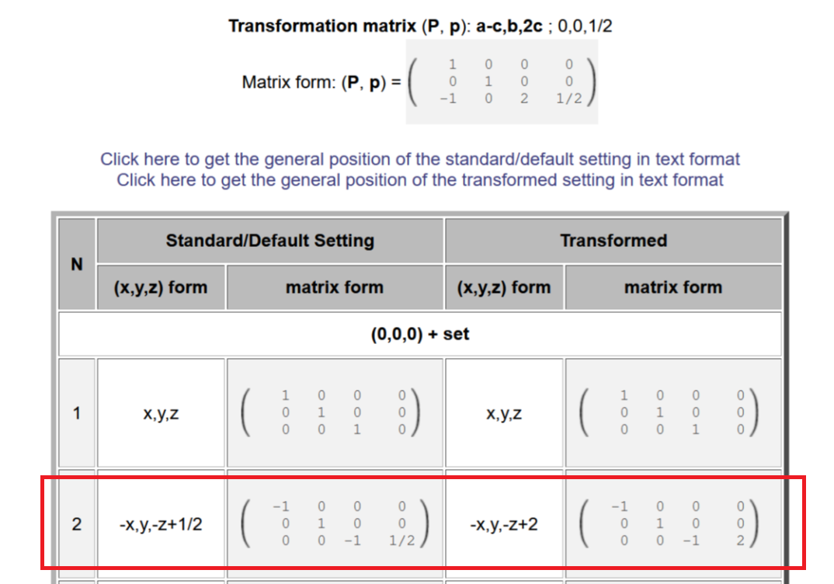
CLEG applications
Jmol scripting for calculation:
https://github.com/BobHanson/CLEG

Slide 29
CLEG applications
Jmol scripting for calculation:
$ P = matrix("a-c,b,2c;0,0,1/2") $ R = symop("-x,y,-z+1/2") $ Q = !P $ print matrix(P * R * Q, "xyz") -x,y,-z+2
https://github.com/BobHanson/CLEG

Slide 30
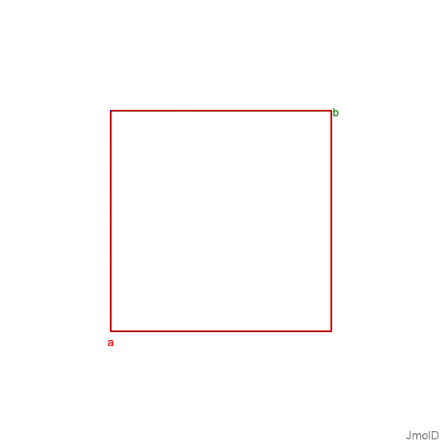
CLEG applications
Jmol scripting for visualization of settings:
modelkit zap spacegroup 140
draw ID uc1 unitcell color red
draw ID ax1 axes
https://github.com/BobHanson/CLEG

Slide 31
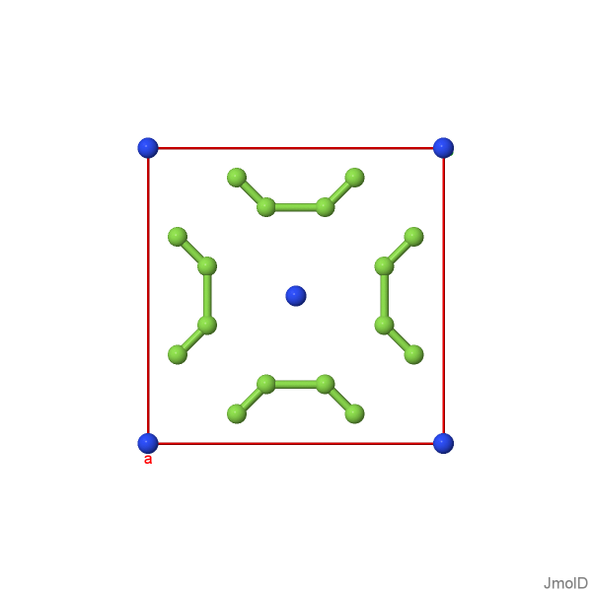
CLEG applications
Jmol scripting for visualization of settings:
modelkit zap spacegroup 140
draw ID uc1 unitcell color red
draw ID ax1 axes
modelkit add F {0.60 0.20 0.25/1}
modelkit add N wyckoff c packed
connect 1.0 2.1
https://github.com/BobHanson/CLEG

Slide 32
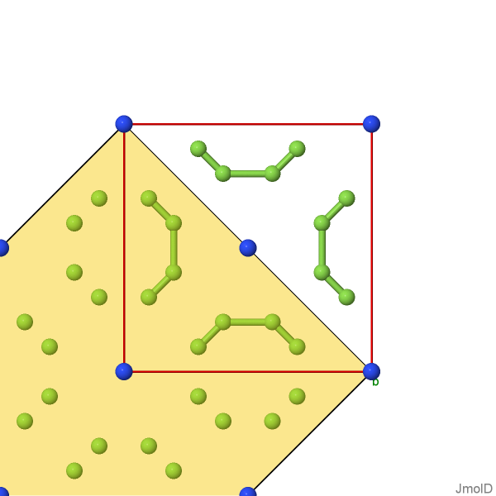
CLEG applications
Jmol scripting for visualization of settings:
modelkit zap spacegroup 140
draw ID uc1 unitcell color red
draw ID ax1 axes
modelkit add F {0.60 0.20 0.25/1}
modelkit add N wyckoff c packed
connect 1.0 2.1
modelkit spacegroup "140:a-b,a+b,c" packed
draw ID uc2 unitcell fill nomesh color translucent 0.8
https://github.com/BobHanson/CLEG

Slide 33
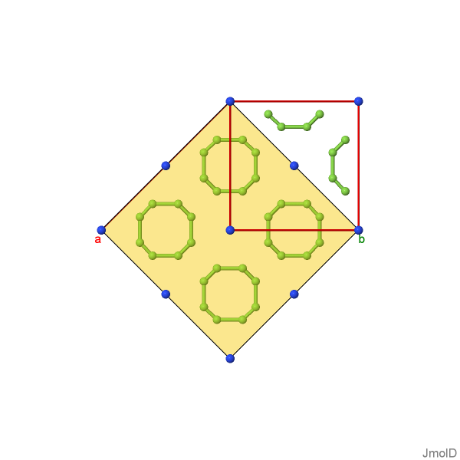
CLEG applications
Jmol scripting for visualization of settings:
modelkit zap spacegroup 140
draw ID uc1 unitcell color red
draw ID ax1 axes
modelkit add F {0.60 0.20 0.25/1}
modelkit add N wyckoff c packed
connect 1.0 2.1
modelkit spacegroup "140:a-b,a+b,c" packed
draw ID uc2 unitcell fill nomesh color translucent 0.8
connect 1.0 2.1; center unitcell; zoom 100
https://github.com/BobHanson/CLEG

Slide 34
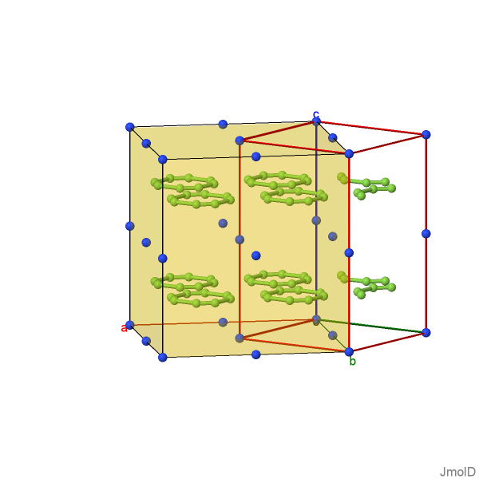
CLEG applications
Jmol scripting for visualization of settings:
modelkit zap spacegroup 140
draw ID uc1 unitcell color red
draw ID ax1 axes
modelkit add F {0.60 0.20 0.25/1}
modelkit add N wyckoff c packed
connect 1.0 2.1
modelkit spacegroup "140:a-b,a+b,c" packed
draw ID uc2 unitcell fill nomesh color translucent 0.8
connect 1.0 2.1; center unitcell; zoom 100
rotate z -35; rotate x -80
https://github.com/BobHanson/CLEG

Slide 35
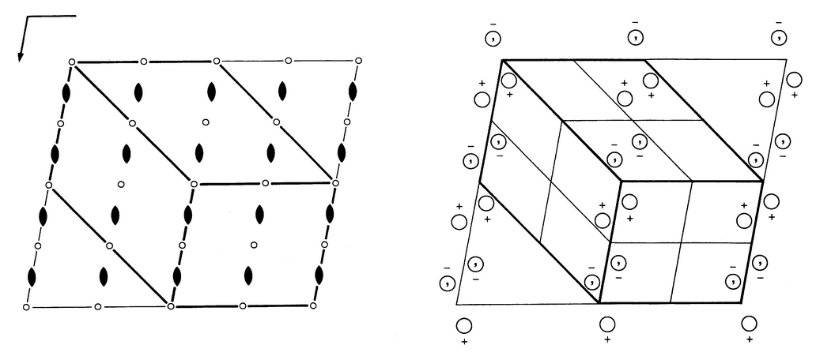
CLEG applications
Jmol scripting for visualization of settings:
Can someone
explain this to me?
https://github.com/BobHanson/CLEG

Slide 36
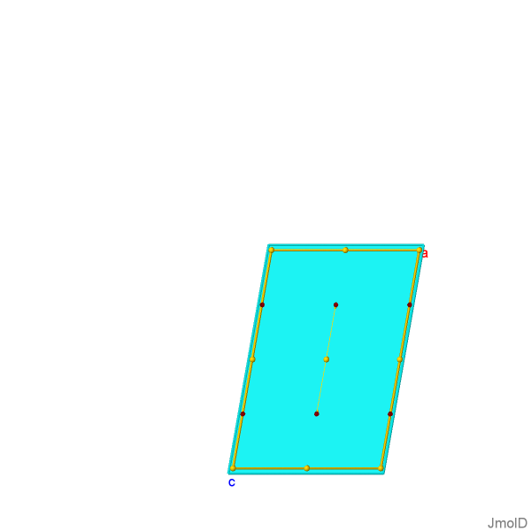
CLEG applications
Jmol scripting for visualization of settings:
modelkit zap spacegroup "13:a,b,c"
moveto axis b1
draw uc1 unitcell
draw sg1 spacegroup all
show symops
1 x,y,z identity
2 -x,y,-z+1/2 2 axis
3 -x,-y,-z Ci: 0 0 0
4 x,-y,z+1/2 c-glide plane|translation: 0 0 1/2
https://github.com/BobHanson/CLEG

Slide 37
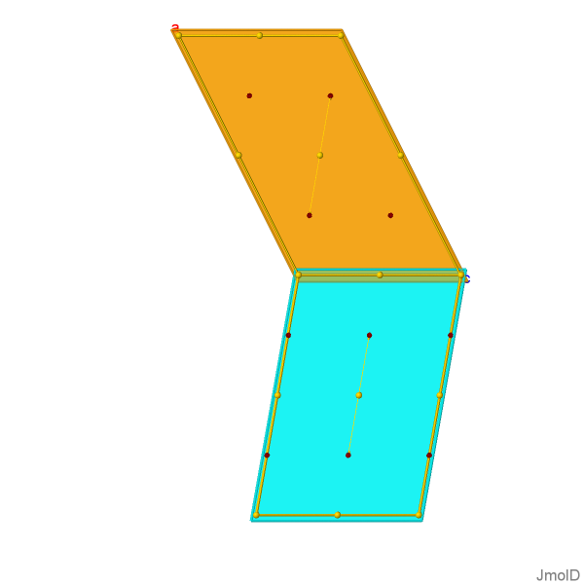
CLEG applications
Jmol scripting for visualization of settings:
modelkit zap spacegroup "13:a,b,c"
moveto axis b1
draw uc1 unitcell
draw sg1 spacegroup all
modelkit spacegroup "13:-a-c,b,a"
draw uc2 unitcell
draw sg2 spacegroup all
https://github.com/BobHanson/CLEG

Slide 38
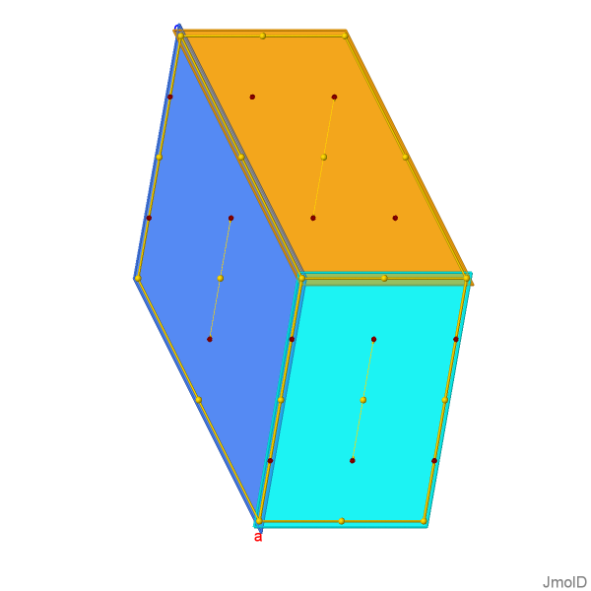
CLEG applications
Jmol scripting for visualization of settings:
modelkit zap spacegroup "13:a,b,c"
moveto axis b1
draw uc1 unitcell
draw sg1 spacegroup all
modelkit spacegroup "13:-a-c,b,a"
draw uc2 unitcell
draw sg2 spacegroup all
modelkit spacegroup "13:c,b,-a-c"
draw uc3 unitcell
draw sg3 spacegroup all
https://github.com/BobHanson/CLEG

Slide 39
CLEG applications
Jmol scripting for visualization of settings:
modelkit zap spacegroup 13.1
moveto axis b1
draw uc1 unitcell
draw sg1 spacegroup all
modelkit spacegroup 13.2
draw uc2 unitcell
draw sg2 spacegroup all
modelkit spacegroup 13.3
draw uc3 unitcell
draw sg3 spacegroup all
https://github.com/BobHanson/CLEG

Slide 40
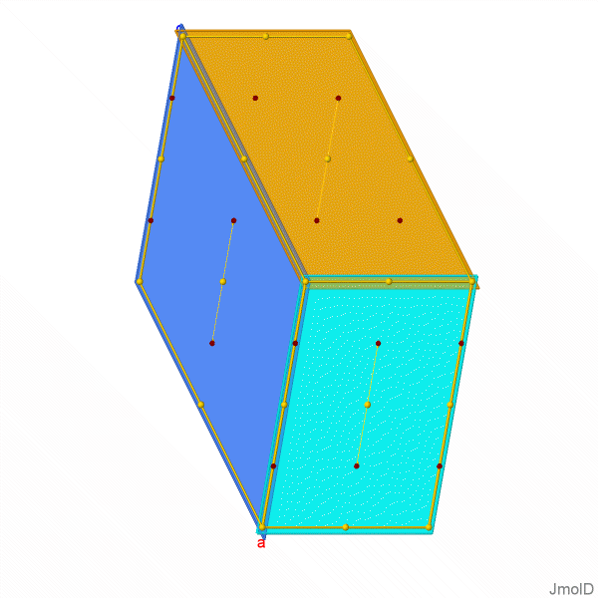
CLEG applications
Jmol scripting for visualization of settings:
modelkit zap spacegroup "13:a,b,c"
moveto axis b1
draw uc1 unitcell
draw sg1 spacegroup all
modelkit spacegroup "13:-a-c,b,a"
draw uc2 unitcell
draw sg2 spacegroup all
modelkit spacegroup "13:c,b,-a-c"
draw uc3 unitcell
draw sg3 spacegroup all
https://github.com/BobHanson/CLEG

Slide 41
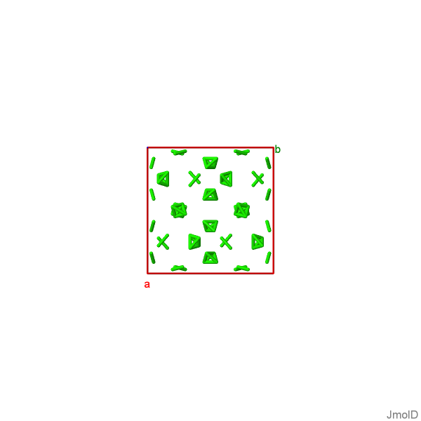
CLEG applications
Jmol scripting for visualization of subgroups:
modelkit zap spacegroup 230
zoom 60
draw ID uc1 unitcell color red
draw ID ax1 axes
modelkit add N Wyckoff G
connect 0.5 1.5
spacefill off
color property site
https://github.com/BobHanson/CLEG

Slide 42
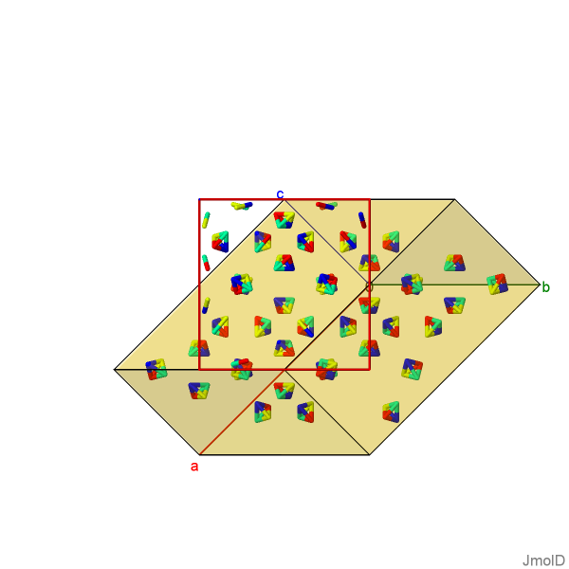
CLEG applications
Jmol scripting for visualization of subgroups:
modelkit zap spacegroup 230
draw ID uc1 unitcell color red
draw ID ax1 axes
modelkit add N Wyckoff G
modelkit spacegroup "230>a-b,b+c,-1/2a-1/2b+1/2c;1/2,1,-1/2>167" packed
draw ID uc2 unitcell fill nomesh color translucent 0.8
connect 0.5 1.5
spacefill off
color property site
spin on
https://github.com/BobHanson/CLEG

Slide 43
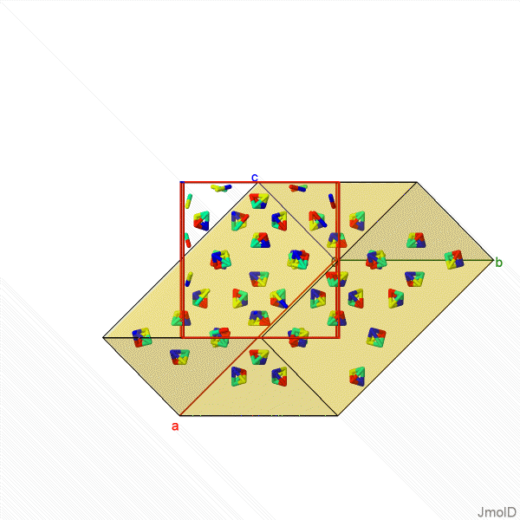
CLEG applications
Jmol scripting for visualization of subgroups:
modelkit zap spacegroup 230
draw ID uc1 unitcell color red
draw ID ax1 axes
modelkit add N Wyckoff G
modelkit spacegroup "230>a-b,b+c,-1/2a-1/2b+1/2c;1/2,1,-1/2>167" packed
draw ID uc2 unitcell fill nomesh color translucent 0.8
connect 0.5 1.5
spacefill off
color property site
spin on
https://github.com/BobHanson/CLEG

Slide 44
CLEG applications
ISODISTORT/Jmol scripting for visualization of subgroups:
ISODISTORT: subgroup tree
Subgroup 1 221 Pm-3m, basis={(0,-1,0),(-1,0,0),(0,0,-1)}, origin=(0,0,0), s=1, i=1 Maximal subgroups: 2 a=4.20000,b=4.20000,c=4.20000,alpha=90.00000,beta=90.00000,gamma=90.00000 Order parameters: GM1+ (a) Active k vectors: (0,0,0) This subgroup does not produce any selected distortions
Subgroup 2 123 P4/mmm, basis={(1,0,0),(0,1,0),(0,0,1)}, origin=(0,0,0), s=1, i=3 Maximal subgroups: 3 a=4.20000,b=4.20000,c=4.20000,alpha=90.00000,beta=90.00000,gamma=90.00000 Order parameters: GM1+ (a) GM3+ (a,0) Active k vectors: (0,0,0)
Subgroup 3 140 I4/mcm, basis={(-1,1,0),(-1,-1,0),(0,0,2)}, origin=(0,0,0), s=2, i=6 Maximal subgroups: a=5.93970,b=5.93970,c=8.40000,alpha=90.00000,beta=90.00000,gamma=90.00000 Order parameters: R4+ (a,0,0) GM1+ (a) GM3+ (a,0) Active k vectors: (1/2,1/2,1/2), (0,0,0)
https://github.com/BobHanson/CLEG

Slide 45
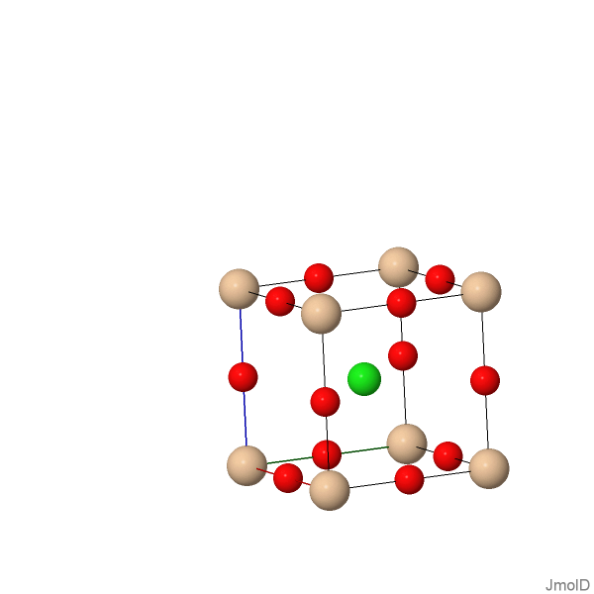
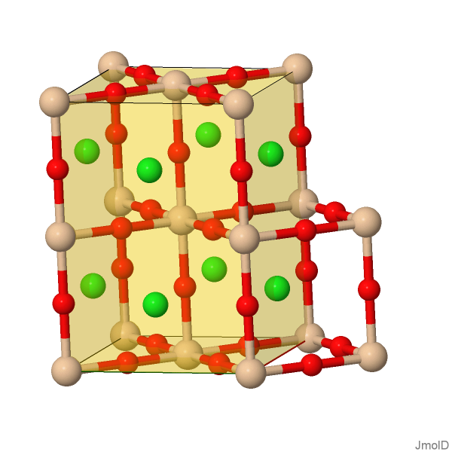
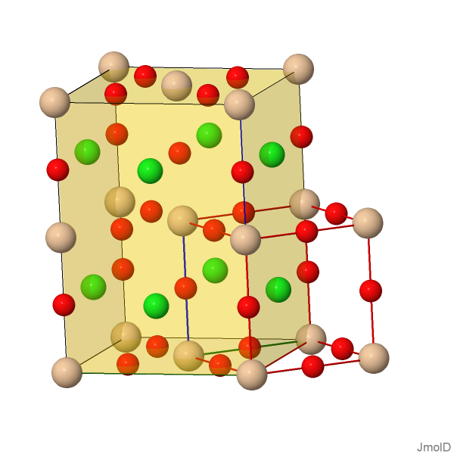
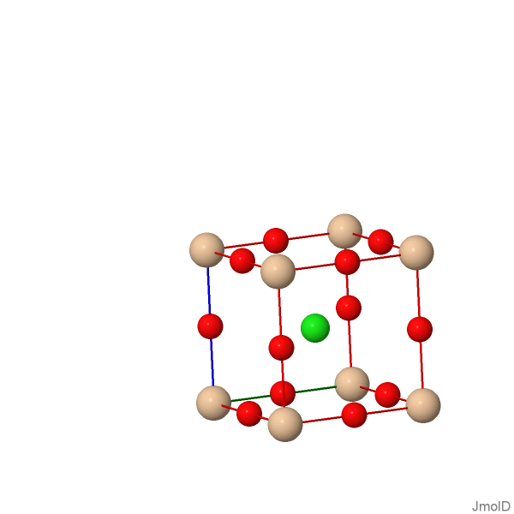
CLEG applications
ISODISTORT/Jmol scripting for visualization of subgroups:
modelkit zap spacegroup "221:-b,-a,-c" unitcell [4.2 4.2 4.2 90 90 90]
modelkit add Si Wyckoff a packed
modelkit add Cl Wyckoff b packed
modelkit add O Wyckoff d packed
https://github.com/BobHanson/CLEG

Slide 46
CLEG applications
ISODISTORT/Jmol scripting for visualization of subgroups:
modelkit zap spacegroup "221:-b,-a,-c" unitcell [4.2 4.2 4.2 90 90 90]
modelkit add Si Wyckoff a packed
modelkit add Cl Wyckoff b packed
modelkit add O Wyckoff d packed
modelkit spacegroup “221:-b,-a,-c > a,b,c > 123” packed
draw ID uc1 unitcell color red
draw ID ax1 axes
https://github.com/BobHanson/CLEG

Slide 47
CLEG applications
ISODISTORT/Jmol scripting for visualization of subgroups:
modelkit zap spacegroup "221:-b,-a,-c" unitcell [4.2 4.2 4.2 90 90 90]
modelkit add Si Wyckoff a packed
modelkit add Cl Wyckoff b packed
modelkit add O Wyckoff d packed
modelkit spacegroup "221:-b,-a,-c > a,b,c > 123” packed
draw ID uc1 unitcell color red
draw ID ax1 axes
modelkit spacegroup “123 > -a+b,-a-b,2c;1,0,0 > 140" packed
draw ID uc2 unitcell fill nomesh translucent 0.8
https://github.com/BobHanson/CLEG

Slide 48
CLEG applications
ISODISTORT/Jmol scripting for visualization of subgroups:
modelkit zap spacegroup “221:-b,-a,-c” unitcell [4.2 4.2 4.2 90 90 90]
modelkit add Si Wyckoff a packed
modelkit add Cl Wyckoff b packed
modelkit add O Wyckoff d packed
modelkit spacegroup “221:-b,-a,-c > a,b,c > 123” packed
draw ID uc1 unitcell color red
draw ID ax1 axes
modelkit spacegroup “123 > -a+b,-a-b,2c;1,0,0 > 140” packed
draw ID uc2 unitcell fill nomesh translucent 0.8
connect 2.0 2.2
https://github.com/BobHanson/CLEG

Slide 49
Summary: CLEG
A Concise Linear Encoding of Crystallographic Space Group Settings and Group-Subgroup Relationships (CLEG)
Simple
P 1 2/m 1 | 10:a,b,c;0,0,0 | P 1 2/c 1 | 13:a,b,c;0,0,0
P 1 1 2/m | 10:c,a,b;0,0,0 | P 1 1 2/n | 13:a,-a-c,b;0,0,0
P 2/m 1 1 | 10:b,c,a;0,0,0 | P 2/b 1 1 | 13:b,c,a;0,0,0
https://github.com/BobHanson/CLEG

Slide 50
Summary: CLEG
A Concise Linear Encoding of Crystallographic Space Group Settings and Group-Subgroup Relationships (CLEG)
Simple
Concise
P 1 2/m 1 | 10 | P 1 2/c 1 | 13:a,b,c
P 1 1 2/m | 10:c,a,b | P 1 1 2/n | 13:a,-a-c,b
P 2/m 1 1 | 10:b,c,a | P 2/b 1 1 | 13:b,c,a
https://github.com/BobHanson/CLEG

Slide 51
Summary: CLEG
A Concise Linear Encoding of Crystallographic Space Group Settings and Group-Subgroup Relationships (CLEG)
Simple
Concise
Comprehensive
10:b,c,a > !b,c,a > 10 nonstandard to standard setting
10 > a-c,b,2c;0,0,1/2 > 13 group to subgroup (standard settings)
13 > a,-a-c,b > 13:a,-a-c,b standard to nonstandard
10:b,c,a > -b+c,-b-c,a:0,1/2,0 > 13:a,-a-c,b nonstandard group to nonstandard subgroup
https://github.com/BobHanson/CLEG

Slide 52
Summary: CLEG
A Concise Linear Encoding of Crystallographic Space Group Settings and Group-Subgroup Relationships (CLEG)
Simple
Concise
Comprehensive
Flexible
10 > -b+c,-b-c,a:0,1/2,0 > 13 (for human or machine consumption) P 2/m 1 1 > -b+c,-b-c,a:0,1/2,0 > P 1 1 2/n (for human consumption) (-P 2y):b,c,a > -b+c,-b-c,a:0,1/2,0 > (-P 2cy):a,-a-c,b (for machine consumption)
https://github.com/BobHanson/CLEG

Slide 53
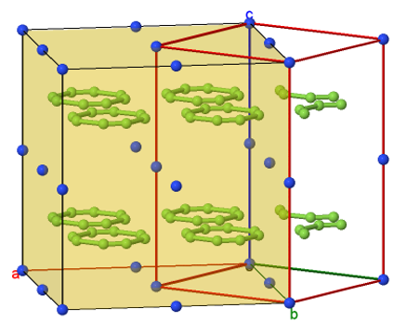
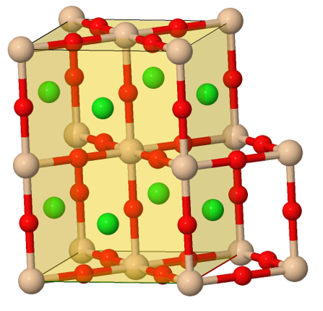
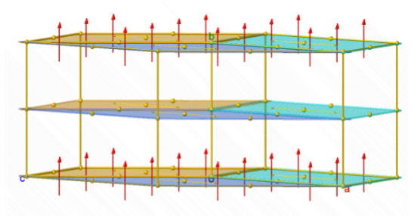
Summary: CLEG
A Concise Linear Encoding of Crystallographic Space Group Settings and Group-Subgroup Relationships (CLEG)
Simple
Concise
Comprehensive
Flexible
And it works!
https://github.com/BobHanson/CLEG

Slide 54
Summary: CLEG
A Concise Linear Encoding of Crystallographic Space Group Settings and Group-Subgroup Relationships (CLEG)
Many thanks to Branton Campbell, Harold Stokes, Mois Aroyo, and Gotzon Madariaga for their patience, support, and many great conversations.
Thank you!
https://github.com/BobHanson/CLEG

Slide 55

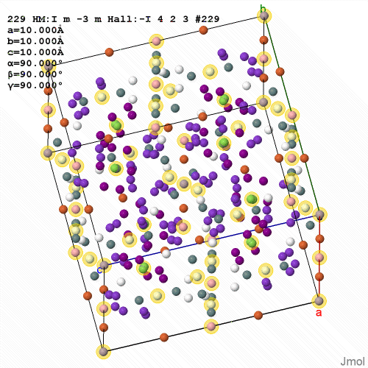
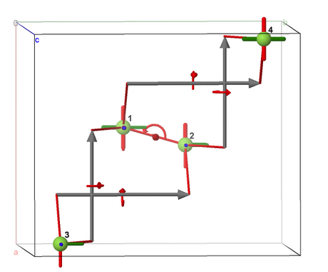
More Jmol implementations this afternoon!
https://github.com/BobHanson/CLEG

